Slide 1
Turn Down the Music! Let Me Hear the Message!!
The critical impact of background music and noise on speech comprehension for radio and TV — and what you can do about it.

Slide 2
Christy Gavitt N-CHATT Trainer; Global Health Consultant
Lise Hamlin HLAA Director of Public Policy

Slide 3
Agenda
What are Music and Noise Maskers?
Making Media Audio Accessible
Call to Action

Slide 4
The Problem: Music and Noise Maskers
Do you listen to radio and do fine – right up until the “man on the street” interview is inserted?
Do you follow along with the TV program until the sound effects or music drowns out the people talking?

Slide 5
Examples of Music and Noise Maskers
NPR’s Morning Edition “bridge” music (old version)
NPR’s Morning Edition “bridge” music – NEW (as of May 6, 2019)
TV Ad
PBS TV show
Notes:
We need to be consistent about how we refer to this. Is it “Speech Masking” or “Noise Masking” or something else?
Also, if we are going to record TV audio, it should not be ads. There are no captioning rules for ads, I don’t see us getting rules for audio access for ads.

Slide 6
Mobile Convention 2019 App Survey
Question #1: Music and noise maskers makes it difficult for me to understand the program:
A) YES B) NO
If yes…
Question #2: Music and noise maskers are a problem when I listen to:
A) RADIO B) TV C) BOTH
Notes:
LH: I’m concerned if we use the word “big” here, people will use it to say “no”. I suggest leaving it at “Speech Masking is a problem when I listen to:”
Also we need to remember to bring hard copy for those who don’t download the mobile app

Slide 7
After Listening to the Clips….
How did it make you feel?
What other kinds of programs on the TV, radio, or internet do you find difficult to understand?
What do you do when you listen these types of programs with music and noise maskers?

Slide 8
Music and Noise Maskers’ Effect on Comprehension
Netherlands study (University of Groningen) – Feb. 2014:
Susceptibility to Interference by Music and Speech Maskers in Middle-Aged Adults
Sample size:
13 young men & women: 19-26 years
12 middle-aged men & women: 51-63 years
→ALL HAD NORMAL HEARING ←

Slide 9
Music and Noise Maskers’ Effect on Comprehension
Significant masking effect (from most to least):
Competing speech
Music
Constant noise

Slide 10
Other Factors (especially for middle-aged and older populations)
Processing speed
Working memory capacity
Distractors/divided and selective attention
Ability to read lips

Slide 11
Music and Noise Maskers’ Effect
People older than 50 years without detectable hearing loss
People 30-50 years old: Earbuds!

Slide 12
Making Media Audio Accessible
FCC regulations on TV has been focused on captioning; access for radio has not been addressed, to the best of our knowledge, to date
The key question: is the audio presented in a way that effectively communicates the programming to the listener?
Notes:
Insert visual about production, delivery and presentation of audio

Slide 13
TV Standards: Dolby AC 4 Standards
Viewers choose the audio they want
For example, sports fans can decide to focus on the announcers or crowd sounds
Viewers adjust the volume of the dialogue
Enables language and accessibility options
https://www.dolby.com/us/en/technologies/AC-4.html

Slide 14
LG TV Smart TV 2018 Sound Mode
Cinema: optimized for movies
Clear Voice: emphasizes dialogue for clearer speech in movies and shows
Sony
Dynamic: Enhances the treble and bass for a clearer sound
Clear Voice: Makes voice clearer by lowering background sound

Slide 15
Samsung
“If you have trouble hearing whispered dialogue or bass, it drowns out other audio whenever things get loud, you can solve most of those problems with audio settings.”
Using “Expert Settings,” you can:
adjust the balance and specific frequencies in the equalizer
select the digital audio format (including Dolby Digital Plus)
change the delay between audio and video tracks
turn automatic volume leveling on and off
https://www.tomsguide.com/us/samsung-tv-settings-guide,review-4663-9.html

Slide 16
Radio: Standards for Accessibility?
Much more diverse universe for radio
Digital FM
Digital AM
HD (proprietary)
Satellite
We did not find the same kinds of technical, open or proprietary standards for consumer audio control for radio that are available for TV

Slide 17
Making Media Audio Accessible
The FCC has oversight of both radio and TV broadcasting
The FCC may be able to adopt or reference standards for accessibility of sound, if:
Technically possible
Demand from consumers: is there a need?

Slide 18
The Need for Advocacy
In the U.S., 48 million people have hearing loss
However, many don’t realize they have a hearing loss or don’t want to take steps to address their hearing loss or the inaccessible world we live in
If we want change, we must speak out!
Notes:
I have trouble with this –
My quibble with “in denial”
2. I’m thinking we should be careful about “speaking for” people who have not expressed an opinion one way or the other.
I suggest:
Over the years, HLAA has received complaints about this problem. We believe now is the time for consumers to speak out!

Slide 19
Initial Efforts
Discussions with WAMU head of technology → NPR
And yet…NPR initially didn’t see it as a problem –
“I can hear the words just fine” (good hearing: a prerequisite of audio engineers)
Perky music – part of their “trademark”
NPR received no complaints!!
4 months later → one change! (a start…)

Slide 20
Advocating for Change for TV
Consumer action
Consumer surveys
Consumer sound masking log
Show the FCC why standards for TV audio are needed and should be adopted
Petition the FCC for a rulemaking

Slide 21
Advocating for Change for Radio
Consumer action
Advocate for better quality sound with producers and broadcasters
Consumer surveys
Consumer sound masking log
Advocate for standards
Petition the FCC once standards are in the works or are available

Slide 22
What Can We Do Now?
Completing the music and noise maskers log
Complete logs by August 1
Return to lhamlin@hearingloss.org or
Via postal mail to HLAA:
Lise Hamlin
Hearing Loss Association of America
7910 Woodmont Avenue, Suite 1200
Bethesda, MD 20814
Notes:
Are there comprehension studies being done now?

Slide 23
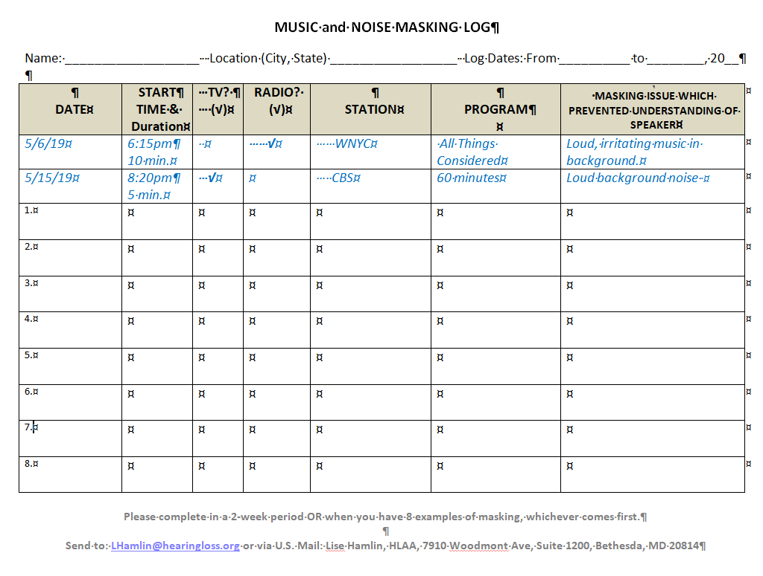
Screen shot of log

Slide 24
What Can We Do Now?
Start the conversation with your local radio and/or TV station
Large scale of problem (middle-aged, too)
Can’t hear = turn off
May impact listening base and possibly advertisers

Slide 25
Send completed logs to:
Lise Hamlin Lhamlin@hearingloss.org
Send complaints to the FCC:
https://consumercomplaints.fcc.gov/hc/en-us

Slide 26
Lise Hamlin
Hearing Loss Association of America
7910 Woodmont Ave, Suite 1200
Bethesda, MD 20814
Lhamlin@hearingloss.org
Christy Gavitt
cgavitt@cox.net

