Slide 1
Amplifying the Next Generation of HLAA Leaders

Slide 2
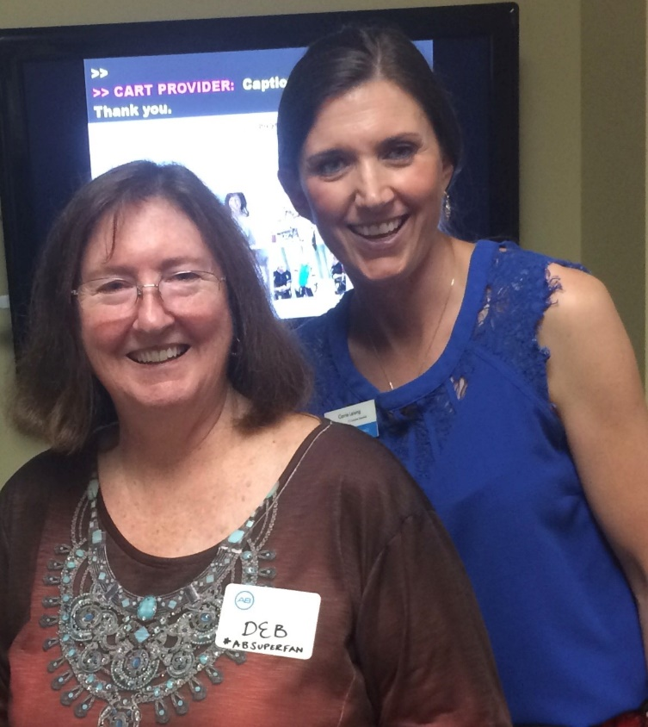
Who are we?
Debra Deitz
Carrie Leising

Slide 4
Hitting rock bottom
-leader stepped down immediately
-poor communication
-chapter started shrinking due to lack of attendance

Slide 5
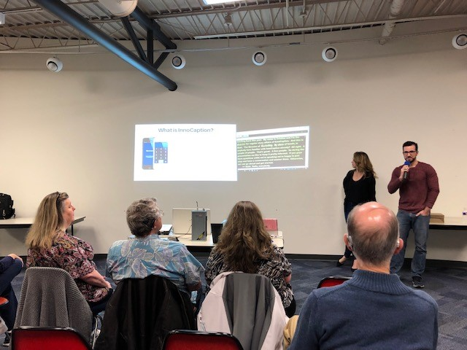
Venues
-split it up north/south
-Free
-good parking
-bathrooms
-good acoustics!

Slide 6
Must haves
-food, and good food too
-captioning
-mics/speakers
-PPTs (visuals)

Slide 7
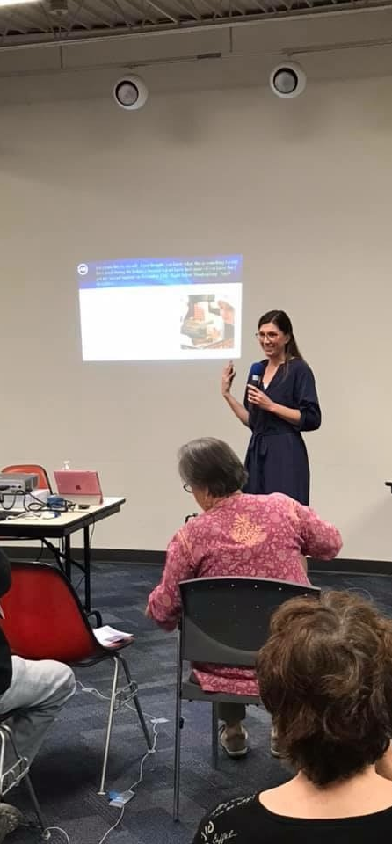
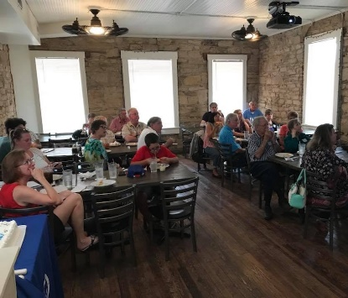
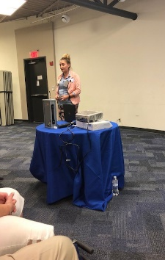
Speaker ideas
-Young adult hearing aid dispenser on ALDs
-Innocaption App
-Navigating Healthcare w/ Hearing Loss
-Pizza Party
-TWC and funding for ALDs, etc.
HINT: Bring in the next generation!

Slide 9
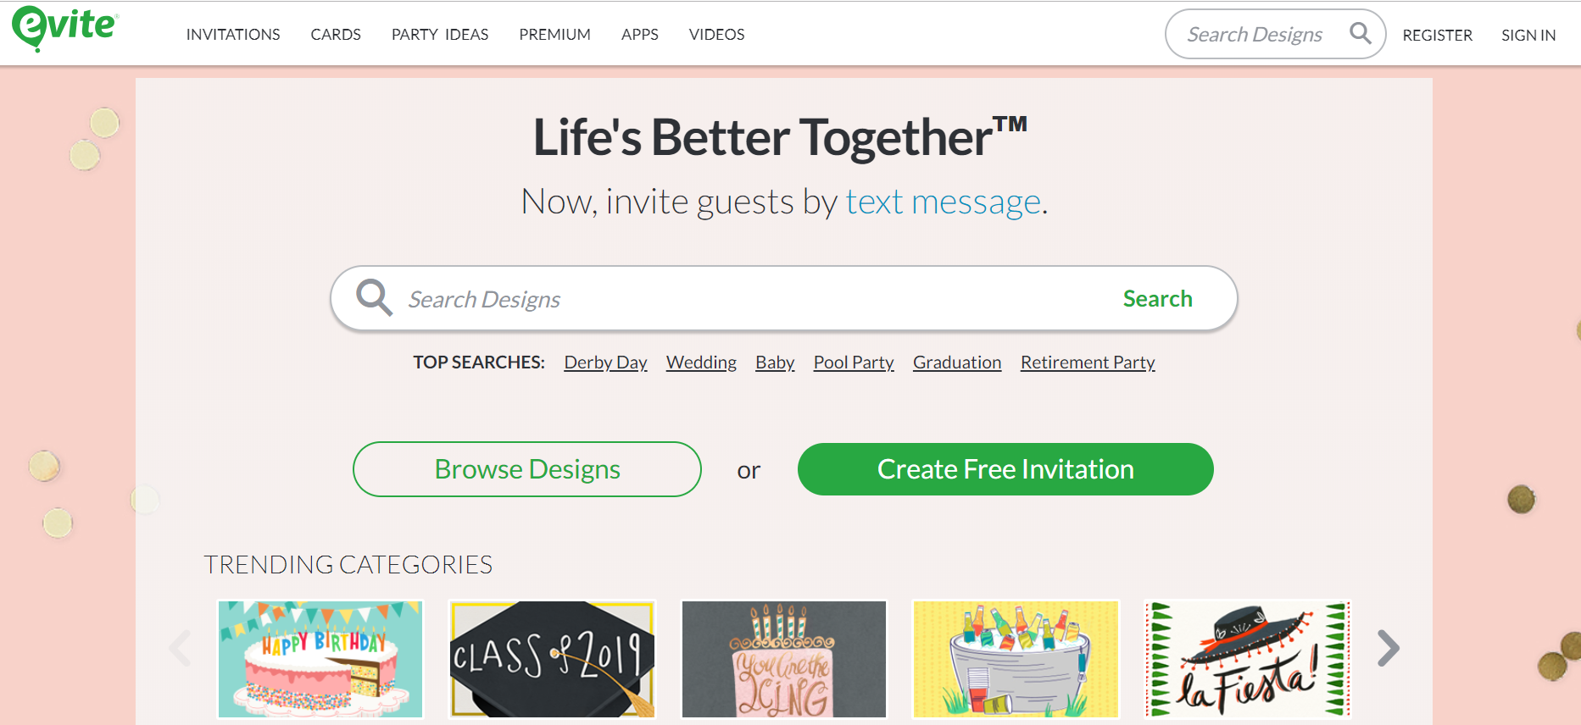
Promotion
-evite
-Social Media
-promote next
event at current
event
-Email reminders more than once
-Redundancy, repeat, regurgitate, re-share the details many times, many ways

Slide 11
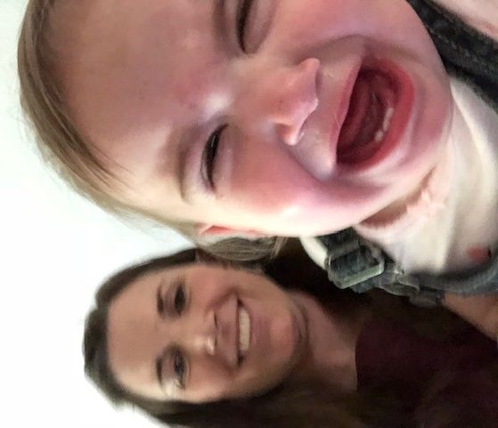
KIDS
-babysitter for families with kids
-have activities for kids
-keep it short and sweet

Slide 12
How often
-every other month
-take summer off
-consistent dates
-Plan in ADVANCE

Slide 13
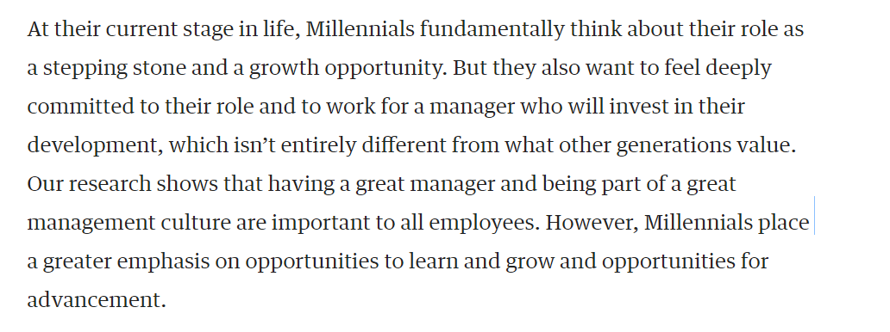
Let IT go!
-Let others own it, to train them
- Harvard Business Review says Millennials want to learn and grow!
-Let it go, let it go, let it go!!!

Slide 14
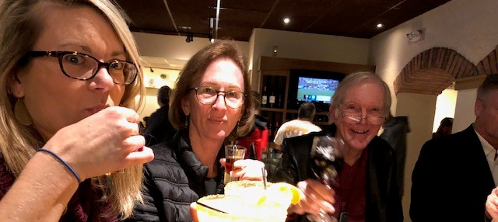
Have fun!

Slide 15
Questions?

