Slide 1
HLAA Advocacy 2019 for Leaders
HLAA2019 Convention
June 22, 2019
Lise Hamlin
HLAA Director of Public Policy

Slide 2
Agenda
Federal and State Laws:
Where Are We? Where Do We Want to Go?
Tips for Effective Advocacy
HLAA Support for Advocacy in the States

Slide 3
Federal and State Laws:
Where Are We?
Where Do We Want to Go?

Slide 4
National Academy of Sciences, Engineering, and Medicine (NAS) Report
June 2, 2016 release: “Affordable and Accessible Hearing Health Care for Adults”
NAS issued 12 Recommendations
nas.edu/hearing

Slide 5
The Over the Counter Hearing Aid Act
NAS Report Recommendation #7: Implement a new category for over-the-counter wearable hearing devices
The OTC Hearing Aid Act, signed into law 8/18/17
OTC hearing devices will be available for adults with mild to moderate hearing loss after 2020
FDA has not yet started the public rulemaking process, expected later this year

Slide 6
The Over the Counter Hearing Aid Act of 2017
We expect this law to change the way hearing health care is delivered in the U.S.
Competition
Innovation
Unbundling
Transparency
Consumer responsibility
HLAA will be educating and informing consumers about OTC products, standards, labeling

Slide 7
Medicare Expansion Bills
HR 1393: “Medicare Dental, Vision and Hearing Benefit Act of 2019,” Rep. Lloyd Doggett (TX)
HR 1518: “Medicare Hearing Aid Coverage Act of 2019,” Rep. Debbie Dingell (MI)
HR 576: “Seniors Have Eyes, Ears, and Teeth Act,” Rep. Lucille Roybal-Allard (CA)

Slide 8
State Laws
Loop legislation
New York City bill provides for the installation of hearing loops in city-funded capital projects
Maryland and Minnesota statues require state funded buildings to include hearing loops
Telecoil legislation
Arizona, Delaware, Florida, New York, Rhode Island and Utah
New this year: Indiana, New Mexico and Washington

Slide 9
State Laws
Hearing aid insurance coverage
4 states require coverage for children and adults: Arkansas, Connecticut, New Hampshire, and Rhode Island
18 states mandate coverage only for children: Colorado, Delaware, Georgia, Illinois, Kentucky, Louisiana, Maine, Maryland, Massachusetts, Minnesota, Missouri, Nebraska, New Jersey, New Mexico, North Carolina, Oklahoma, Oregon, Tennessee, and Texas
Wisconsin requires coverage not only for hearing aids but also for cochlear implants for children

Slide 10
State Laws
Return policies for hearing aids
28 states: no mandatory return policy in place
30-day trial period for most states
45-day trial period for Minnesota, New Mexico, New York and Vermont
“Restocking fees” can be 10 percent – or higher

Slide 11
Tips for Effective Advocacy

Slide 12
Tips for Effective Advocacy: Planning
Developing a strategy with supporters
Stressing local and personal impact
Finding the best legislator to champion your bill
Acknowledging the importance of legislative staff
Addressing the opposition
Working as a team – No Lone Rangers!
Working with HLAA headquarters’ staff

Slide 13
Tips for Effective Advocacy: Engaging Constituents
Making it easy, understanding its importance
Getting chapter/state members sending emails or writing letters
Using the legislator's comment page, Facebook or Twitter accounts
Attending Town Hall meetings
Meeting face to face with local staffers
Becoming the trusted experts

Slide 14
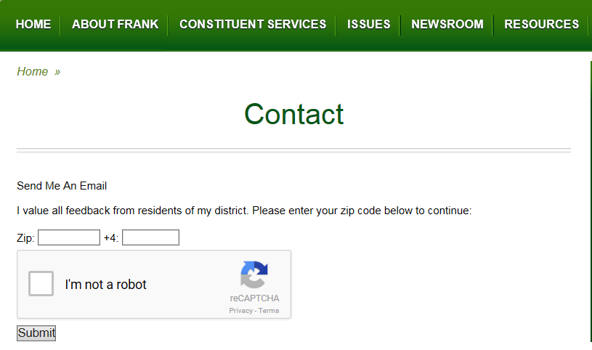

Slide 15
Roger Manno Democrat, District 19, Montgomery County
James Senate Office Building, Room 102 11 Bladen Street
Annapolis, MD 21401
410.841.3151, 301.858.3151 1.800.492.7122, ext. 3151 (toll free) email: roger.manno@senate.state.md.us fax: 410.841.3740, 301.858.3740

Slide 16
HLAA Support for Advocacy
in the States

Slide 17
HLAA Supports State Advocates
In the works: new section of the HLAA website: www.hearingloss.org under HLAA Advocacy section
Text of recent legislation/statutes
Model bills
Talking points
Advocacy Tips

Slide 18
HLAA Supports State Advocates
In the works: new section of the HLAA website www.hearingloss.org under HLAA Advocacy section
We need your feedback!
What should be included, or left out
Is it helpful?

Slide 20
Lise Hamlin, Director of Public Policy
Hearing Loss Association of America
7910 Woodmont Avenue, Suite 1200
Bethesda, MD 20814
www.hearingloss.org
lhamlin@hearingloss.org

